Slide 1
STRATEGIC INVESTING
FOR MINISTERS

Slide 2
AGENDA
Why is financial stewardship so important?
When should I start planning for my financial future?
How do I determine my goals?
How can GuideStone help?
How should I choose my investments?
How can I try to stay on track?

Slide 3
Why is financial stewardship so important?
Notes:
“May he give you the desire of your heart and make all your plans succeed.” Psalms 20:4

Slide 4
What is financial stewardship?
>
>
Managing financial resources with care
Planning for your future with wisdom
Making thoughtful choices for you and your loved ones
May He give you the desire of your heart and make all your plans succeed
(Psalm 20:4).

Slide 5

Why is financial stewardship so important?
By taking responsibility for your financial well-being, you can:
Honor God by making wise financial decisions.
Become a good steward by actively planning ahead.
“A steward manages and leads what is not his own, knowing that he will give an account to the Lord as the owner and ruler of all.”
– Dr. Albert Mohler Jr., Southern Baptist Theological Seminary President
Notes:
- Ministers and church leaders need to be experienced in making financial decisions.
- This is a big responsibility and will help protect your church.
- It’s about becoming stewards of the assets God gives us.

Slide 6
When should I start planning for my financial future?
Notes:
When do you start planning? Right now, if you haven’t already.

Slide 7

START TODAY
The sooner you begin saving, the easier it is to prepare — so don’t wait!

Slide 8
The High Cost of Waiting
Growth if saved $100/month
at 6% earnings
until age 65
Total Savings
Forfeited Savings
Began Saving at Age
This hypothetical illustration is intended to demonstrate compounding and is not intended to illustrate the performance of any actual program. The hypothetical illustration shows a constant rate of return, whereas actual rates of return may fluctuate. Account values were obtained by using a nominal rate of return compounded monthly. Contributions are made at the beginning of the period.
Notes:
While it may be true that, with career changes or raises, you could have more money to invest when you are older, it is also true that the shortened time that your investments will have to grow will mean that it will actually cost you more to get the same result than if you had started earlier.
The biggest mistake you can make is assuming you don't have any money to save. If you earn an income, it's simply a matter of how you're spending it. You probably can put some money aside each month — if you make saving for your future a priority. The longer you wait the more money you will need to save each month to make up for lost time.

Slide 9
How do I determine my goals?

Slide 10

KEY THINGS TO CONSIDER
FUTURE FINANCES
How much money will you need for the future?
TIME HORIZON
What is your time horizon? (How long until you retire?)
SOURCES OF INCOME
What are your retirement sources of income?
Notes:
Do you plan to continue working in retirement? (Continued ministry)

Slide 11

Rules of Thumb
Need to replace 70% to 90% of your final year’s income.
Social Security replaces 25% to 40% of the income you’ll need.
A good savings goal would be 8 to 10 times your annual salary in the year of retirement.
Notes:
Source: SSA.gov/news/press/factsheets/basicfact-alt.pdf
Most financial planners suggest you’ll need to replace 70 to 90 percent of your final year’s income to maintain your standard of living after you retire. It will be hard to get by on less than this, and you may need more if you have additional retirement expenses such as high debt, major medical costs, or if you’re still paying on a home mortgage.
Social Security benefits typically provide 25 to 40 percent of the retirement income you will need. This percentage varies based on several factors such as your income levels during your working career and the age at which you retire. The average Social Security benefit today for an individual taxpayer is approximately $16,000 per year. You should check the annual benefit statement you receive from Social Security to see your own personalized benefit estimate.
Example:
Let’s pull these general “rules of thumb” together by using an example of a person getting ready to retire with a $50,000 annual income. If we assume an 80 percent replacement value, this person will need approximately $40,000 in retirement income. By subtracting the $16,000 average Social Security benefit, we see an additional $24,000 will be needed each year to reach this person’s annual retirement income goal. Take a moment to use these rules of thumb to create your own personal estimate. If you are following along in the workbook, use the blank space provided in the notes section to write your calculations. First, write your own annual income. Next, multiply it by 80 percent to see how much you would need if you were retiring today. Assuming you will be eligible for Social Security, subtract the current average benefit of $16,000 from this amount. This gives you a general idea of the annual income you would need from your retirement plan and other investments if you were retiring today.

Slide 12
How can GuideStone help?

Slide 13

What is GuideStone’s 403(b) Church Retirement Plan?
Offered to you as an employee of your church
Similar to 401(k)
Defined contribution plan

Slide 14
State Convention Benefits
Eligible participants receive:
Disability income benefit (up to $500 per month)
Survivor protection benefit (up to $100,000)
Matching retirement contribution (up to $210 annually)
Check with your state convention to learn more.

Slide 15
Retirement Contributions Are Essential to Meeting Your Goals
GuideStone® recommends an employer contribution of 10%.
If offered, never leave a match on the table.
Work toward a savings goal of 15% or more.
Avoid taking loans or pre-retirement withdrawals.
Notes:
GS MATCH - explain
Pay yourself first
Automate it
Direct deposit to a savings account
Auto-transfer to savings account
“Keep the change” programs
Think about spending in terms of hours
If I make $10 an hour and buy something that costs $100, is it really worth the 10 hours I worked?
Think about your priorities
If you’re about to make a purchase, ask yourself if this money could be used for a higher priority

Slide 16

What types of contributions can be made to your account?
Employer contributions
Employee tax-sheltered contributions
Employee Roth contributions
Rollover contributions

Slide 17

Tax-Sheltered Contributions for Ministers
Reduction of taxable income in year of contribution
Deferred taxation of contributions and earnings
Contributions exempt from SECA
Tax-free housing allowance in retirement

Slide 18

Roth Contributions for Ministers
Contributions are taxable for federal, state and SECA taxes
No taxation of qualified distributions

Slide 19
How should I choose my investments?

Slide 20

The nation’s largest Christian-screened mutual fund family
GUIDESTONE FUNDS
Investments that honor Christian values
Diversified fund offering
Personalized investment options
vv

Slide 21
Proper Diversification
Time horizon
Risk tolerance
Individual investment goals

Slide 22
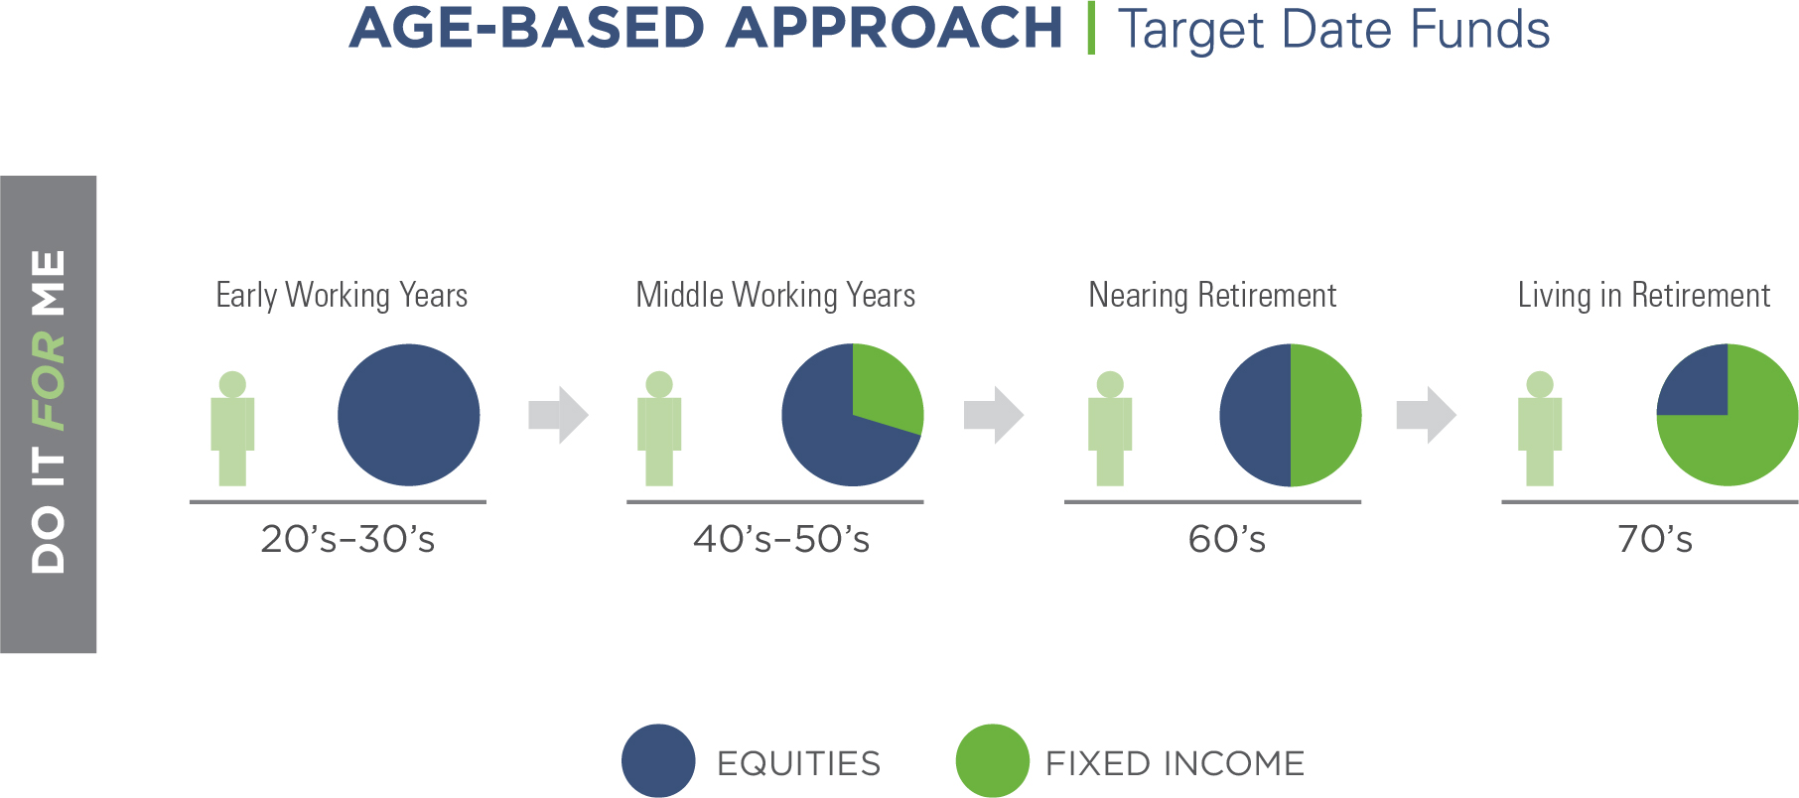

Slide 23
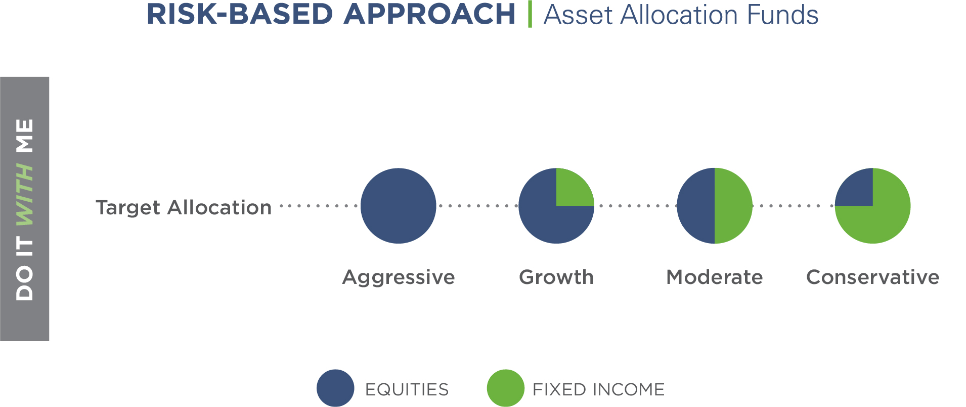

Slide 24
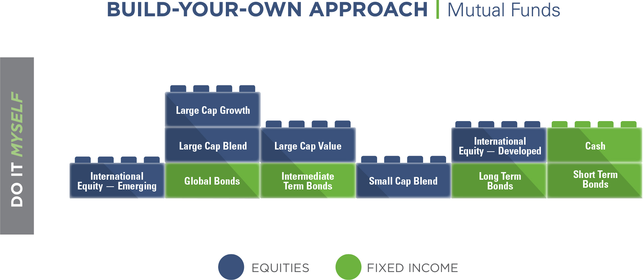

Slide 25
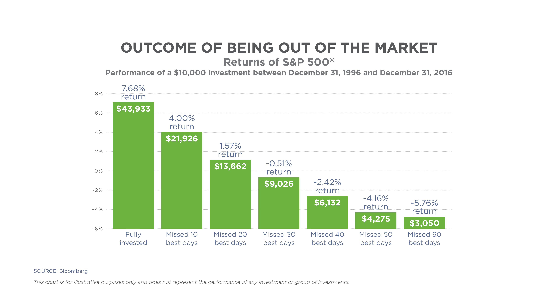
Notes:
Source: Importance of Planning GS PowerPoint (GS Data)

Slide 26

GuideStone Can Help
Retirement planning & guidance
  Investment Recommendation Tool
  Financial calculators
  Learning Library
Customer solutions specialists

Slide 27
How can I try to stay on track?

Slide 28
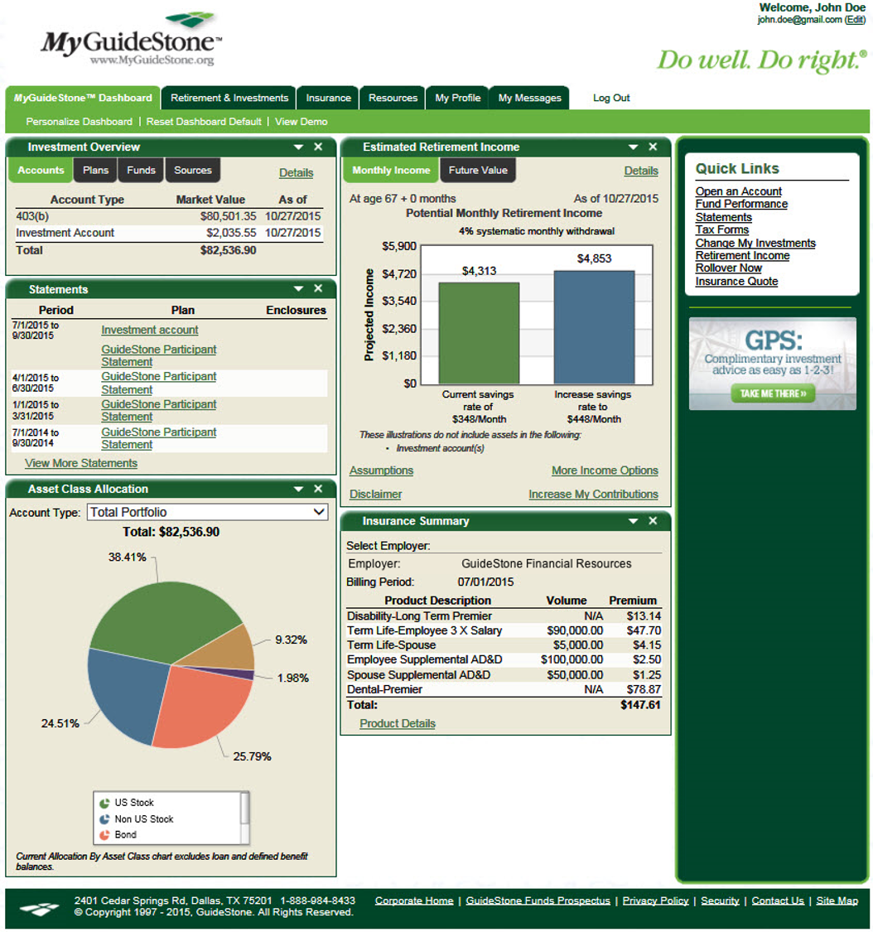
MyGuideStone®
Notes:
To get connected, all you need to do is visit MyGuideStone.org and enter your user ID and password.
If you do not have a user ID, simply select the "Register Now" button to get connected in three simple steps.
Through MyGuideStone you will have 24–7 access to your own personalized account information.
(Discuss MyGuideStone features.)

Slide 29
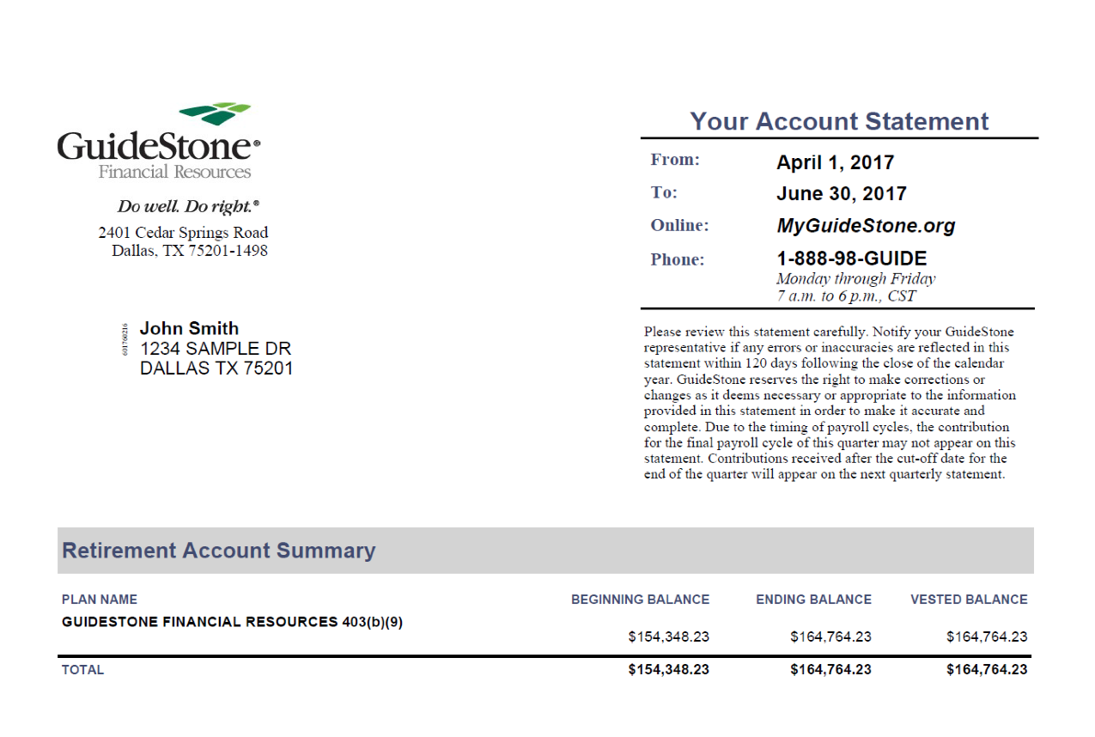
Quarterly Account Statement

Slide 30

TAKE ACTION
Focus on what’s in your control.
Enroll in your plan if you haven’t yet done so.
Increase your contributions.
Monitor your plan and make adjustments as needed.

Slide 31

CONTACT US
Call us today at 1-888-98-GUIDE (1-888-984-8433), Monday through Friday between 7 a.m. and 6 p.m. CST.
Chat live online or email our financial professionals.
GuideStone
@GuideStone
@GuideStone_
GuideStone Financial Resources

Slide 32
GuideStone is here for you.
Helping participants since 1918 Retirement plan expertise Nonprofit organization
No competing interests
Our bottom line — your retirement security

Slide 33
The MyDestination Funds® (“Funds”) attempt to achieve their objectives by investing in the GuideStone Select Funds and other investments. The Funds are managed to a retirement date (“target date”) by adjusting the percentage of fixed income securities and equity securities to become more conservative each year until reaching the retirement year and then approximately 15 years thereafter. The target date in the name of the Funds is the approximate date when an investor plans to start withdrawing money. The expense ratio for the Funds includes the expenses of the underlying Select Funds. The principal risks of the Funds will change depending on the asset mix of the Select Funds in which they invest. You may directly invest in the Select Funds and other investments. The Funds’ value will go up and down in response to changes in the share prices of the investments that they own. The amount invested in the Funds is not guaranteed to increase, is not guaranteed against loss, nor is the amount of the original investment guaranteed at the target date. It is possible to lose money by investing in the Funds.
The Asset Allocation Funds (“Funds”) attempt to achieve their objectives by investing in the GuideStone Select Funds. The expense ratio for the Funds includes the expenses of the underlying Select Funds. The principal risks of the Funds will change depending on the asset mix of the Select Funds in which they invest. You may directly invest in the Select Funds. The Funds’ value will go up and down in response to changes in the share prices of the investments that they own. It is possible to lose money by investing in the Funds.
As of September 30, 2017, GuideStone Funds has $12 billion in assets, which makes GuideStone Funds the nation’s largest Christian-screened mutual fund family. No other fund family with a Christian screen exceeds GuideStone Funds in asset size.

Slide 34
GuideStone Financial Resources® (“GuideStone”) is not undertaking to provide impartial investment advice or to give advice in a fiduciary capacity. GuideStone has a financial interest in GuideStone Funds. GuideStone and its affiliates receive management fees and service fees from the Funds. When plan assets are invested in GuideStone Funds, the amount of management fees and service fees received by GuideStone and its affiliates increases. The amount of fees paid to GuideStone and its affiliates by GuideStone Funds varies by fund. Fees paid to GuideStone and its affiliates are higher in those GuideStone Funds that are funds of funds, because the funds of funds bear their proportionate share of the fees of the underlying GuideStone Funds in which they invest (in addition to bearing their own fees). For more detailed information regarding the fees and expenses of the GuideStone Funds, please refer to the GuideStone Funds prospectus.
You should carefully consider the investment objectives, risks, charges and expenses of the GuideStone Funds® before investing. A prospectus with this and other information about the Funds may be obtained by calling 1-888-GS-FUNDS (1-888-473-8637) or downloading one at GuideStoneFunds.com. It should be read carefully before investing.
GuideStone Funds and retail investment products are made available through GuideStone Financial Services®, member FINRA. Shares of GuideStone Funds are distributed by Foreside Funds Distributors LLC.

Slide 35
Notes:
We hope you have benefited from this presentation and the time we have spent together. As we conclude, we leave you with two important thoughts that summarize our commitment to you as a GuideStone participant.
Do Well. At GuideStone Financial Resources, we strive to do well. For more than nine decades we’ve been enhancing the financial security of ministers, church and institutional employees and seminary students. Our reputation is built on our quality products and a proven track record of helpful customer services.
Do Right. We share common values with you. We believe that doing what’s right matters. Our retirement products and investment funds seek to be competitive while remaining faithful to Christian values and goals. We are here for your benefit. No competing interests. Our bottom line is your bottom line — retirement security.
Thank you for letting us help you with your retirement security needs. We appreciate your involvement with GuideStone and we look forward to many continued years of serving the investment needs of you and your family.

