Slide 1
HIDDEN DESCRIPTION SLIDE — NOT TO BE SHOWN TO THE PUBLIC
Retirement Income Solutions
Catalogue code: A20
Full presentation or module? Full presentation
Slide numbers: A20-1 to A20-18
Registered/Non-Registered Usage: Allowed for all (Choices: registered rep use only, not for registered rep use, allowed for all, partial limitations)
Last update info: Date updated: 2015-01-29 Project #25408 Description of changes: Update background template
Filed with FINRA? No If yes, date:
Notes:

Slide 2
Retirement Income Solutions
A20-1

Slide 3
Why You Need a Good Strategy
RETIREMENT INCOME SOLUTIONS
A faulty strategy can lead to:
Unrealistic plans
Uncertain future
Outliving retirement income
A20-2
Notes:
First, it’s important to understand why you need a good strategy for your retirement income. Without a good strategy, you can end up making plans that are unrealistic, preparing poorly for the future or worse, outliving your retirement income.

Slide 4

What does a good strategy look like?
RETIREMENT INCOME SOLUTIONS
Built upon three keys:
Considers longevity
Adjusts for inflation
Includes loved ones
A20-3
Notes:
A good strategy, like the one presented here, is generally built upon three keys.
First, it considers longevity by providing a dependable income stream for the remainder of you and your spouse’s life.
Next, it adjusts for inflation throughout the 20–30 years you may spend in retirement. This is important because historically, inflation has risen by about 3% per year.
Finally, it includes provisions for loved ones by helping you provide income for your spouse, children, grandchildren or others, should you precede them in death.

Slide 5
Income and Expense Categories
RETIREMENT INCOME SOLUTIONS
Income
Essential expenses
Discretionary expenses
A20-4
Notes:
We’ll help you to develop this strategy by walking you through your estimated retirement income and expense needs.
To begin, you’ll estimate your income before retirement and your expected income during retirement.
Then, you’ll examine your essential expenses. These include things like housing, food, utilities, health care and other necessities.
Lastly, we’ll help you calculate your discretionary expenses, which are potentially recurring expenses that often arise when extra income is available.

Slide 6
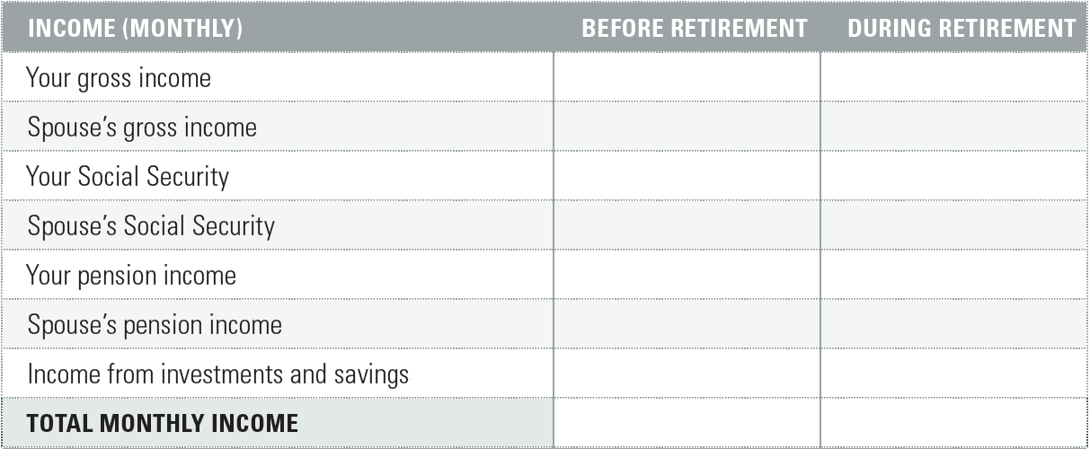
Estimated Income
RETIREMENT INCOME SOLUTIONS
A20-5
Notes:
We’ll start by addressing your estimated income needs. These estimates should take all income sources into account, including your gross income, spouse's income, Social Security payments, pensions and any income from investments and savings.

Slide 7
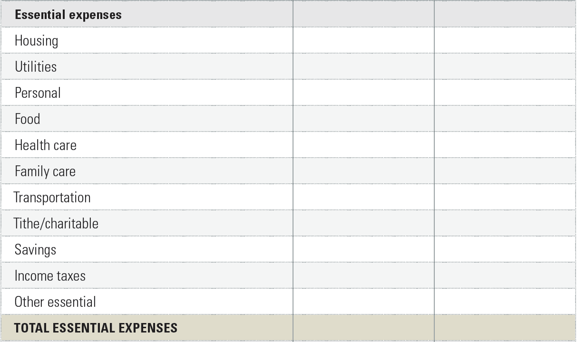
Essential Expenses
RETIREMENT INCOME SOLUTIONS
A20-6
Notes:
The next step is to use the workbook to address your essential expenses. These are basic necessities that are recurring and fluctuate very little from month to month such as housing, utilities, food and health care.

Slide 8
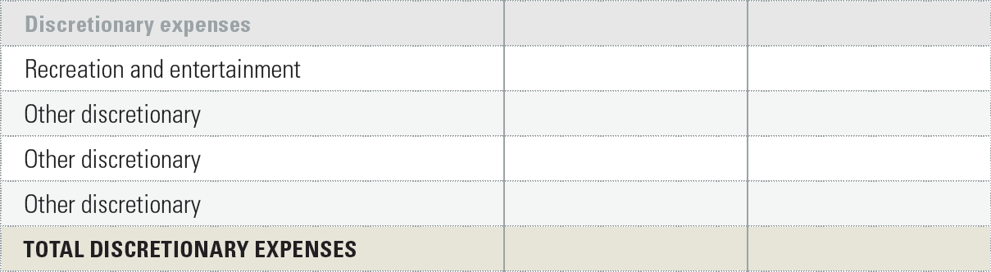
Discretionary Expenses
RETIREMENT INCOME SOLUTIONS
A20-7
Notes:
The final step is to estimate your discretionary expenses. These are non-recurring expenses that usually come up after your other expenses have been met. Examples include entertainment and recreation.

Slide 9
Understand Your Options
RETIREMENT INCOME SOLUTIONS
Life Income Annuity
Systematic Withdrawal Plan
Fixed Period Income Annuity
Single Sum Withdrawal
A20-8
Notes:
Now that we've addressed your income and expense needs, let’s look over the retirement income options you need to know about. We’ll look over what you need to know about GuideStone’s Life Income Annuity, Systematic Withdrawal Plan, Fixed Period Income Annuity and Single Sum Withdrawal options.

Slide 10
Life Income Annuity
RETIREMENT INCOME SOLUTIONS
Payable for one (Single Life) or two (Joint Life) lives
Cash Refund option
Specified Period option
Annual Increase option
A20-9
Notes:
First, we’ll talk about the Life Income Annuity. With this option, you will receive income payments for the rest of your life or the lives of both you and your Joint Life Applicant. There are also several ways to customize your Life Income Annuity. You can choose a Cash Refund option to ensure your children or other beneficiaries receive proceeds in the event you or you and your spouse pass away before the original purchase price of the annuity is paid out.
Alternatively, you could choose a Specified Period option that allows children or other beneficiaries to receive proceeds if you or you and your spouse pass away before a specified period, such as 10 years, is over.
Or you could choose an Annual Increase option that allows you to receive annual increases of 1%, 2% or 3% in return for smaller initial payments. This can help offset inflation's impact on your retirement income.
You will receive important information regarding annuities when you request an application. Please read the information carefully.

Slide 11
Systematic Withdrawal Plan
RETIREMENT INCOME SOLUTIONS
Provides income for a specified period of time
Option 1: Equal payments of a specified amount
Option 2: Percentage of total vested contribution amounts
Option 3: Paid out over a specified period
A20-10
Notes:
Next, let’s look at a Systematic Withdrawal Plan. This option provides monthly retirement income until the funds are exhausted or until written notification to cancel the plan is received. There are three basic ways to receive your withdrawals.
You can choose to receive equal payments of a specified amount as long as it’s at or above the minimum of $50. Or, if you prefer, you could choose to receive a percentage of total vested contribution amounts. This option uses a formula to determine a monthly payment amount that can vary from month to month due to market fluctuations. Also, if the account balance drops below $1,000, the account will be distributed to you as a Single Sum Payment.
Lastly, you can choose to have your Systematic Withdrawal paid out over a specified amount of time. With this option, you choose a time span, such as 10 or 15 years, and your account balance is simply divided among that length of time to determine your approximate monthly payment. As with the previous option, your payment will vary from month to month due to market fluctuations.

Slide 12
Systematic Withdrawal Plan
RETIREMENT INCOME SOLUTIONS
Account stays invested while you take withdrawals
Experts recommend starting at no more than 4%
Any other options are funded first
A20-11
Notes:
Before choosing a Systematic Withdrawal Plan, there are three points to consider. First, it's important to note your account stays invested while you take withdrawals. So you will need to be comfortable with your risk level as you will be responsible for all investment decisions. Second, you will want to keep in mind that most experts recommend starting your withdrawal rate at no more than 4% of your account balance annually to reduce your chances of running out of money.
And finally, please note that if you set up multiple retirement income payment options, any annuity, fixed period or single sum options you select will be set up first. Any remainder of your retirement funds will then be available for your Systematic Withdrawal Plan.

Slide 13

Fixed Period Income Annuity
RETIREMENT INCOME SOLUTIONS
Payable as a fixed monthly amount for a specified period
You decide the amount and/or period
Annuity is affected by several variables
A20-12
Notes:
The next option to consider is the Fixed Period Income Annuity. It allows you to receive fixed monthly payments for a specified period. You get to decide the amount and/or the payment period, and at the end of that period, no other benefits will be paid. This option is affected by several variables, including the amount of the balance used to establish payments, length of payments, frequency of payments and the funding rate at the time the benefit is established. Also, your employer’s plan may limit your annuity to only a portion of your vested Employer Contributions Account. Keep in mind that if you die before the fixed period ends, your beneficiary has the option to continue receiving payments in the same amount for the remainder of the payment period, or as a Single Sum Payment.

Slide 14
Single Sum Payment
RETIREMENT INCOME SOLUTIONS
Provides all or part of income in one payment
May be limited to vested amount
Can create adverse tax consequences
A20-13
Notes:
The last payment type to consider is the Single Sum Payment. This option allows you to receive all or part of your balance in one single payment. However, your employer’s plan may limit a Single Sum Payment to only a portion of your vested Employer Contributions Account. You’ll need to keep in mind that Single Sum Payments can cause adverse tax consequences — make sure to talk with your tax advisor for more details. Also, you’ll want to note that Single Sum Payments can only be withdrawn from an accumulations account, not from an established annuity.

Slide 15
An Important Note About Annuities
RETIREMENT INCOME SOLUTIONS
If you choose a Life Income Annuity, Systematic Withdrawal or Fixed Period Income Annuity that is payable for 10 years or more, your income is subject to voluntary withholding rules. If you choose a Single Sum Payment, Systematic Withdrawal or Fixed Period Income Annuity that is payable for less than 10 years, your income will be subject to the mandatory 20% withholding rules.
A20-14
Notes:
Please keep in mind that if you choose a Life Income Annuity, Systematic Withdrawal or Fixed Period Income Annuity that is payable for 10 years or more, your income is subject to voluntary withholding rules. And if you choose a Single Sum Payment, Systematic Withdrawal or Fixed Period Income Annuity that is payable for less than 10 years, your income will be subject to the mandatory 20% withholding rules.

Slide 16
What if my expenses exceed my retirement income?
RETIREMENT INCOME SOLUTIONS
Potential ways to generate income:
Making a hobby profitable
Continuing employment
Working as a consultant
Retiring to an area with a lower cost of living
Moving to a less expensive house
Disposing of unused assets
A20-15
Notes:
Have you considered other ways to generate income during retirement? Possibilities may include:
Turning a hobby into a money-making opportunity
Continuing to work on a full- or part-time basis or serving as a consultant
Retiring to an area with a lower cost of living
Reducing expenses by moving to a less expensive house
Disposing of unused assets

Slide 17

What if my expenses exceed my retirement income?
RETIREMENT INCOME SOLUTIONS
Benefits to delaying retirement:
Social Security
Savings
Health care
A20-16
Notes:
You may also need to consider delaying vocational retirement. There are several benefits to continuing your career:
Social Security. Delaying Social Security until age 70 may be appropriate and can provide you with a higher starting benefit as well as a higher annual increase. It is also important to consider that, while some Social Security benefits can begin as early as age 62, full retirement age for the oldest Baby Boomers is actually age 66, and, for younger Baby Boomers (and anyone born after 1960), full retirement age is 67.
Savings. Continued employment allows you more time to contribute to your retirement plan and for your investments to potentially grow. It also reduces the number of years you need to stretch your retirement investments.
Health care. Many employers may continue health care benefits for you as you work. This is especially important if you are retiring before becoming Medicare-eligible.
Retirement can still be very much a part of your plans; it just may require fine-tuning your goals to make it a comfortable reality.

Slide 18

GuideStone Is Here to Help
RETIREMENT INCOME SOLUTIONS
For any questions or to request your Retirement Income Solutions workbook:
1-888-98-GUIDE (1-888-984-8433)
Monday through Friday
7 a.m. to 6 p.m. CST
Email us at
info@GuideStone.org
A20-17
Notes:
We hope this presentation has been a helpful resource for you. If you haven’t already, please be sure to contact GuideStone to request your Retirement Income Solutions workbook so that you can estimate your expenses and take a proactive step toward meeting your retirement income needs.
And should you have questions or need any assistance, please don’t hesitate to contact us:
By phone toll-free at 1-888-98-GUIDE (1-888-984-8433)
Or by email at info@GuideStone.org

Slide 19
A20-18

