Slide 1
HIDDEN DESCRIPTION SLIDE — NOT TO BE SHOWN TO THE PUBLIC
Compensation Planning Guide
Catalogue code: B08
Full presentation or module? Full
Slide numbers: B08-1 to B08-38
Registered/Non-Registered Usage: All
(Choices: registered rep use only, not for registered rep use, allowed for all, partial limitations)
Last update info:
  Date updated: 2014-12-18
  Project #25410
  Description of changes: update background to new template, update slide B08-21, and slide B08-23.
Filed with FINRA? No If yes, date:
Notes:

Slide 2
Compensation Planning Guide
B08-1

Slide 3
Overview
COMPENSATION PLANNING GUIDE
Compensation planning:
Why it’s important
Who is responsible
Before you begin
Six essential steps
B08-2

Slide 4
A. Why It’s Important
COMPENSATION PLANNING GUIDE
Honors God’s Word
For the Scripture says, “You shall not muzzle an ox while it treads out the grain,” and, “The laborer is worthy of his wages” (1 Tim. 5:18 NKJV).
“Even so the Lord has commanded that those who preach the gospel should live from the gospel”
(1 Cor. 9:14 NKJV).
B08-3

Slide 5
A. Why It’s Important
COMPENSATION PLANNING GUIDE
Provides structure and protection:
Ensures appropriate spending
Clarifies personal income
Extends employee tenure
Protects minister and church
Enhances clarity and stability
Helps church comply with tax regulations
B08-4

Slide 6
Overview
COMPENSATION PLANNING GUIDE
Compensation planning:
Why it’s important
Who is responsible
Before you begin
Six essential steps
B08-5

Slide 7
B. Who Is Responsible
COMPENSATION PLANNING GUIDE
Church treasurer
Personnel committee
Ministers
Church employees
B08-6

Slide 8
Overview
COMPENSATION PLANNING GUIDE
Compensation planning:
Why it’s important
Who is responsible
Before you begin
Six essential steps
B08-7

Slide 9
C. Before You Begin (Page 2)
COMPENSATION PLANNING GUIDE
Benefits of a compensation plan
Dangers of lump sum or package approach
Eligibility requirements of a Minister for
Tax Purposes
B08-8

Slide 10
C. Before You Begin (Page 2)
COMPENSATION PLANNING GUIDE
Benefits of a compensation plan:
  It reduces confusion
  It ensures funds are spent appropriately
  It lets ministers and staff know you value them
B08-9

Slide 11
C. Before You Begin (Page 2)
COMPENSATION PLANNING GUIDE
Benefits of a compensation plan
Dangers of lump sum or package approach:
  Often causes ministers to pay higher taxes
  May lead to a financial hardship for the church
  Distorts minister’s amount of actual income
B08-10
Notes:
The dangers of a lump sum or package approach.
Paying a lump sum amount to your minister to break down as he desires can be unwise.
It often causes ministers to pay higher taxes, increasing financial burdens for their families.
It can lead to a financial hardship for the church if a minister does not set aside a portion of the lump sum for insurance coverage.
It distorts the amount of actual income the minister has available to provide for his family.

Slide 12
C. Before You Begin (Page 2)
COMPENSATION PLANNING GUIDE
Benefits of a compensation plan
Dangers of lump sum or package approach
Eligibility requirements of a Minister for
Tax Purposes:
  Ordained, licensed or commissioned
  Administers ordinances
  Conducts worship
  Management responsibilities
  Religious leader
B08-11
Notes:
The eligibility requirements of a Minister for Tax Purposes
Generally, a Minister for Tax Purposes is ordained, licensed or commissioned and fulfills a majority of the following: administers the ordinances; conducts religious worship; has management responsibilities and is considered to be a religious leader by the church.

Slide 13
C. Before You Begin (Page 2)
COMPENSATION PLANNING GUIDE
Ministers for Tax Purposes — dual tax status:
  Employee for income tax purposes
  Self-employed for Social Security purposes
B08-12
Notes:
These ministers have a dual tax status. They are employees for income tax purposes and self-employed for the purpose of Social Security.
They are exempt from federal income tax withholding.
They are eligible for a church-designated housing allowance.
They must pay SECA taxes for Social Security coverage (employees pay half as much in FICA taxes and their employer pays the other half).

Slide 14
C. Before You Begin
COMPENSATION PLANNING GUIDE
Ministers for Tax Purposes:
  Exempt from mandatory federal income tax withholding
  Eligible for church-designated
  housing allowance
  Must pay SECA taxes for Social Security coverage
B08-13

Slide 15
Overview
COMPENSATION PLANNING GUIDE
Compensation planning:
Why it’s important
Who is responsible
Before you begin
Six essential steps
B08-14

Slide 16

Create Your
Compensation Plan
COMPENSATION PLANNING GUIDE
Six essential steps:
Step 1. Determine the needs
B08-15

Slide 17
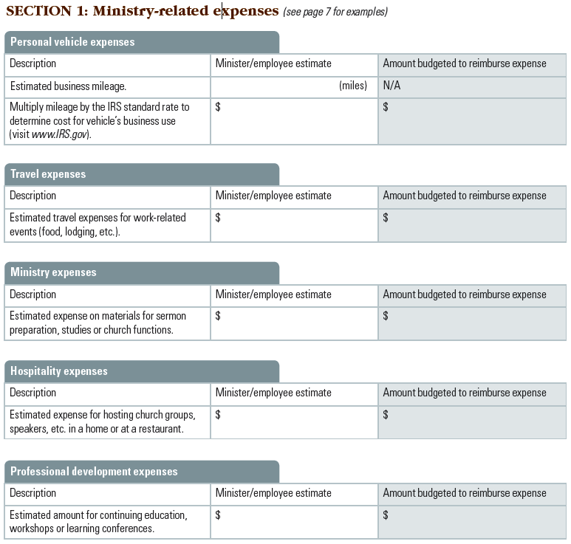
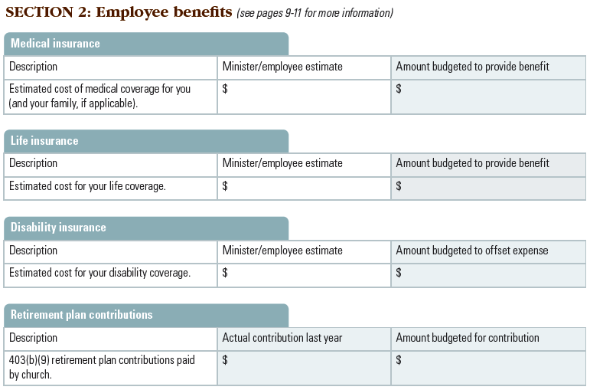
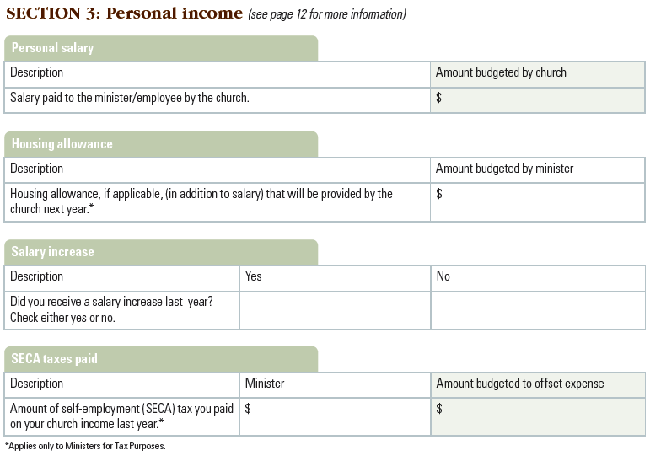
Step 1:
Determine the Needs (Pages 4–5)
COMPENSATION PLANNING GUIDE
Compensation
Plan Review
Ministry-related expenses
Employer-provided benefits
Personal income
B08-16

Slide 18
Create Your Compensation Plan
COMPENSATION PLANNING GUIDE
Six essential steps:
Step 1. Determine the needs
Step 2. Establish written policies
B08-17

Slide 19
Step 2:
Establish Written Policies (Page 6)
COMPENSATION PLANNING GUIDE
Policies should cover four major areas:
Ministry-related expenses
Employee benefits
Personal income
Personnel policies
B08-18

Slide 20
Create Your Compensation Plan
COMPENSATION PLANNING GUIDE
Six essential steps:
Step 1. Determine the needs
Step 2. Establish written policies
Step 3. Provide for ministry-related expenses
B08-19

Slide 21
Step 3:
Provide for Ministry-Related Expenses (Page 7)
COMPENSATION PLANNING GUIDE
Address these expenses with an
Accountable Reimbursement Plan (ARP)
Vehicle use for business purposes
Meetings, workshops and conferences
Books, periodicals, software, etc.
Continuing education opportunities
Provisions for ministry-related hospitality
B08-20

Slide 22

Step 3:
Provide for Ministry-Related Expenses
COMPENSATION PLANNING GUIDE
(Page 7)
Requirements for an ARP
Expenses must have a business purpose
Document amount, date, place
and purpose
Expenses substantiated within
60 days
Excess advances returned
within 120 days
B08-21

Slide 23
Step 3:
Provide for Ministry-Related Expenses (Page 7)
COMPENSATION PLANNING GUIDE
Requirements for an ARP
IRS-approved standard rate for transportation (mileage rate), meals and lodging
Unused ARP money should not be given as a bonus or additional income
(See page 15 of workbook for sample ARP)
B08-22

Slide 24
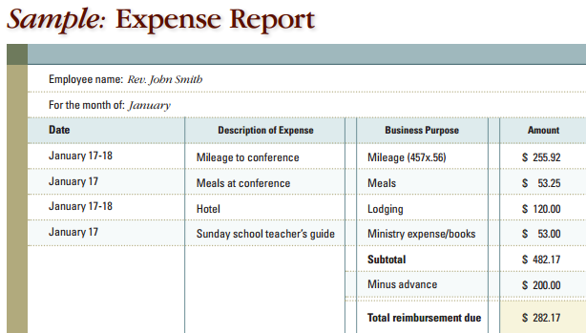
Step 3:
Provide for Ministry-Related Expenses (Page 8)
COMPENSATION PLANNING GUIDE
Create an ARP in three easy steps:
Determine covered expenses and create a plan
Require expense
reports to be
submitted within 60
days of incurring
expenses
Reimburse approved
expenses at least
once a month
B08-23
Notes:
A word of caution about reimbursement arrangements through
salary reduction
It is strongly recommended that a church chooses not to reduce a minister’s or employee’s personal income by the amount of an expense. According to Treasury Regulation 1.62(d), that type of salary reduction will qualify as a non-accountable arrangement, and the church will have to report the amounts on the minister’s or employee’s Form W-2 as income. In general, the minister or employee will have to pay more taxes if the church chooses this option.

Slide 25
Create Your Compensation Plan
COMPENSATION PLANNING GUIDE
Six essential steps:
Step 1. Determine the needs
Step 2. Establish written policies
Step 3. Provide for ministry-related expenses
Step 4. Provide employee benefits
B08-24

Slide 26
Step 4:
Provide Employee Benefits (Page 9)
COMPENSATION PLANNING GUIDE
A strong benefit plan
Has tax advantages
Offers insurance coverage benefits
  Protects church
  Provides appropriate coverage for staff
Includes retirement contributions
B08-25
Notes:
A strong benefit plan includes retirement plan contributions, medical, life and disability coverage for ministers. Having this type of plan shows tangible concern for your church’s staff, which can reduce turnover and increase attractiveness for potential new employees. It also provides some of the following advantages.

Slide 27
Step 4:
Provide Employee Benefits
COMPENSATION PLANNING GUIDE
Insurance coverage can include:
Term life
Employee accident
Medical
Disability
Dental
B08-26

Slide 28
Step 4:
Provide Employee Benefits (Page 10)
COMPENSATION PLANNING GUIDE
A retirement plan
Paid service ends: income needs do not
Employer contributions
Employee contributions
B08-27

Slide 29
Step 4:
Provide Employee Benefits (Page 10)
COMPENSATION PLANNING GUIDE
A GuideStone retirement plan features:
Tax-sheltered contributions
Designed exclusively for ministries
No SECA taxes for eligible ministers
Housing allowance benefit
Roth contributions (not available in all plans)
B08-28

Slide 30
Step 4:
Provide Employee Benefits (Page 11)
COMPENSATION PLANNING GUIDE
The Church Retirement Plan for SBC churches
Potential benefits
  Disability income
  Survivor protection
  Matching contribution
Mission Church Assistance Fund (MCAF)
B08-29
Notes:
DELETE SLIDE FOR XM PRESENTATIONS
www.GuideStone.org/SBCChurchBenefits
www.GuideStone.org/MCAF

Slide 31
Create Your Compensation Plan
COMPENSATION PLANNING GUIDE
Six essential steps:
Step 1. Determine the needs
Step 2. Establish written policies
Step 3. Provide for ministry-related expenses
Step 4. Provide employee benefits
Step 5. Determine personal income
B08-30

Slide 32

Step 5:
Determine Personal Income
(Page 12)
COMPENSATION PLANNING GUIDE
Factors for determining personal income:
Responsibilities and experience
Inflation
Social Security
Minister’s housing allowance
B08-31

Slide 33
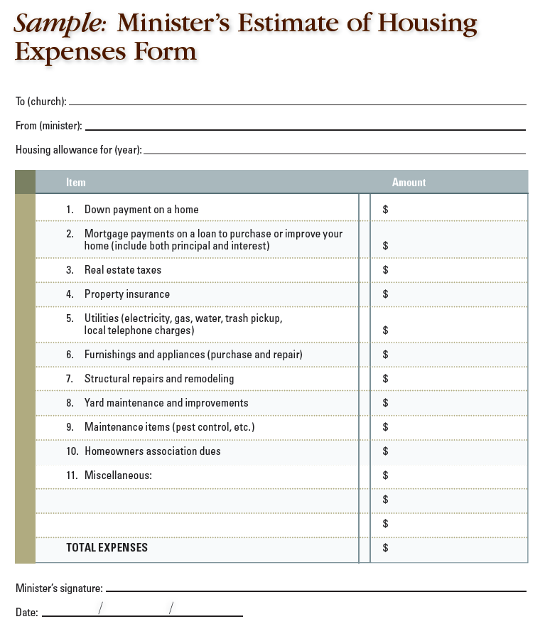
Step 5:
Determine Personal Income (Page 12)
COMPENSATION PLANNING GUIDE
How to designate a housing allowance:
Minister’s responsibility
  Present an estimate of
  housing expenses
Church’s responsibility
  Designate amount prior
  to paying minister
  Review annually
  Record it as set until
  changed by official decision
  Remember housing
  allowance limits
B08-32

Slide 34
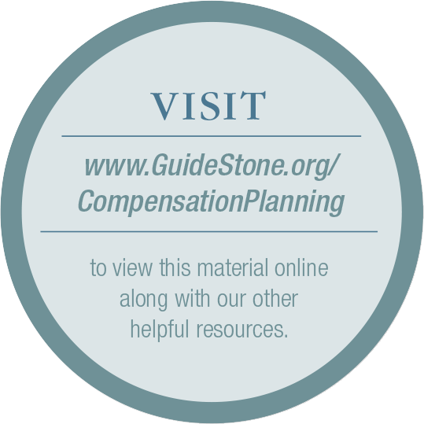
Step 5:
Determine Personal Income
COMPENSATION PLANNING GUIDE
Use the SBC Compensation Study
See compensation trends for ministers and staff at like-sized SBC churches in your region
Help determine adequate compensation for your church staff
B08-33

Slide 35
Create Your Compensation Plan
COMPENSATION PLANNING GUIDE
Six essential steps:
Step 1. Determine the needs
Step 2. Establish written policies
Step 3. Provide for ministry-related expenses
Step 4. Provide employee benefits
Step 5. Determine personal income
Step 6. Complete a compensation
planning summary
B08-34

Slide 36
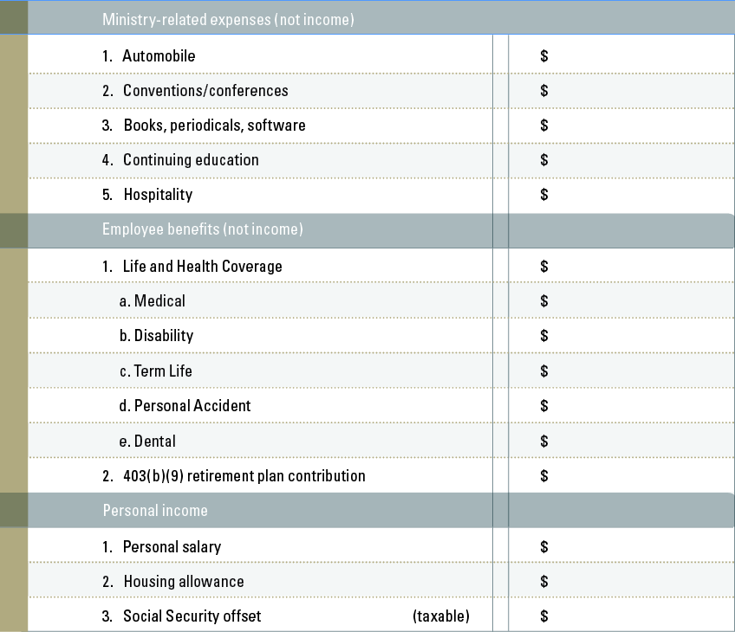
Step 6:
Complete a Compensation Planning Summary (Page 14)
COMPENSATION PLANNING GUIDE
About the summary
Develops plan for new budget year
Categories are not to be added together
Be mindful of federal reporting requirements for churches (see our Ministers’ Tax Guide)
B08-35

Slide 37
Next Steps
COMPENSATION PLANNING GUIDE
Church reviews and implements the six steps:
Determine the needs
Establish written compensation policies
Provide for ministry-related expenses
Provide employee benefits
Determine personal income
Complete a compensation
planning summary
B08-36

Slide 38

Contact GuideStone with Any Questions
COMPENSATION PLANNING GUIDE
1-888-98-GUIDE (1-888-984-8433)
  7 a.m. to 6 p.m. CST, Monday through Friday
Info@GuideStone.org
B08-37

Slide 39
B08-38

